Slide 1
The IWCA National Medical Partnership Program
Presented by CBIZ
CBIZ Employee Benefits is proud to be your master broker of the 2022 IWCA National Medical Partnership Program

Slide 2
US Small Businesses:
Employ nearly half of the US workforce
Account for 64% of all the new jobs created in the US
Provide most of the innovation
- 14 X more patents than large businesses and universities
And:
Pay more in taxes
Have higher costs per employee
Have smaller budgets and less access to resources with which to compete

Slide 3
Every four years the National Federation of Independent Businesses surveys its more than 300,000 members to determine what are the biggest problems facing small businesses.
Since 1986 the same problem has been at the top of the list..

Slide 4
“The U.S. spends more on health care as a share of the economy — nearly twice as much as the average OECD* country — yet has the lowest life expectancy …among the 11 nations.”
- The Commonwealth Fund (30 January, 2020)
*(Organization for Economic Co-operation and Development)

Slide 5
The IWCA Partnership Program
The IWCA Partnership Program’s mission is to give employees access to truly affordable ACA-compliant health insurance built on COPAY PLANS, not High Deductibles
It is for anyone wanting an alternative to the traditional health insurance providers who have under-served small businesses, moderate income employees, hourly workers and part-timers.
Popular Industries
Hospitality & Restaurants | Transportation/Logistics
Automotive | Landscaping
Manufacturing | Janitorial
Construction/Trades | Warehouse
Maintenance | Retail
Golf Courses | Security
Day Care Centers | Staffing
Health Care | Beauticians
Employees Served
Hourly
Salary
Part-Time
Full-Time
Seasonal
Temps
Union
Low-Middle Income

Slide 6
IWCA Medical Impacts Each Part of Your Premium
Not to scale

Slide 7
The IWCA Medical Partnership Program
Finally a platform of affordable health benefits for employers to offer to every employee…hourly workers, part-time, seasonal, salaried employees.
ACA-compliant Plans available in all fifty (50) states!
Each employer is their own Plan Sponsor…The IWCA Partnership Program is not a PEO Master Plan, MEWA or Association Health Plan.
No census required to obtain a proposal for the IWCA Medical Partnership Program plans.
Group Health Questionnaire (GHQ) will be completed but no Personal Employee Health Questionnaires required.
Hybrid Level-funded/Self-insured Program (no employer financial obligation beyond paying monthly billable rates).
Reinsurance Coverage: If the Employer/Plan Sponsor desires to purchase the reinsurance coverage from a reinsurance carrier domiciled in Puerto Rico, USA, the Employer/Plan Sponsor may travel to Puerto Rico to purchase the coverage or they will be referred to a legal counsel in Puerto Rico to avail themselves of attorney-in-fact representation services to facilitate direct procurement of first-dollar coverage for claims risks under the plans ($25 annual fee). Such coverage shall only be provided through a fully licensed and capitalized insurance carrier domiciled in Puerto Rico, which maintains excess reinsurance coverage through one or more A-rated reinsurers to supplement its capital and liquidity.
Direct Procurement taxes of 1 - 6% may apply and will be added to the monthly invoice. Direct procurement tax filing service, if applicable to and desired by the Plan Sponsor, is available for $50 per month.
Plan administration: Provided by leading TPAs such as Aither Health.
Top-rated prescription program management provided by Capital Rx, a leading PBM.

Slide 8
The IWCA Medical Partnership Program
MVP BRONZE, SILVER & GOLD LIMITED DAY MEDIAL (LDM) PLANS
Providing Affordable ACA-Compliant Access to Healthcare
Physician Office Visits – Copay in and out of network
In-Network Doctor – Paid the PHCS/Multiplan network rate
Out-of-Network Doctor – Paid the 85th percentile of usual and customary charges (UCR)
Access to National PPO Networks such as PHCS/MultiPlan (1,200,000 professionals) and others.
Hospital Services – No Network Restrictions. Covered 100% after Copay For Covered Days/Services
“Buy-Up” Options To MVP Ultra Plan or MVP HSA HDHP Plan Both eliminate day limits and cover services excluded in the Bronze, Silver & Gold limited day medical plans
Employees also have access to Supplemental Coverage for; additional hospitalization benefits, cancer insurance, critical illness (i.e. heart attack, kidney disease, etc.), accident insurance to fill in any gaps they wish in the IWCA plan coverage
Lower cost Minimum Essential Coverage (MEC) plans also available

Slide 9
The IWCA Medical Monthly Billable Rates (includes administration costs and risk assessment fees)
Minimum Value Plans (MVP) Satisfying ACA Parts A and B
INN: In-Network/OON: Out-of-Network (excludes direct procurement tax) | MVP Bronze LDM | MVP Silver LDM | MVP Gold LDM | MVP Ultra Copay Plan | MVP Ultra HSA HDHP
PHCS/MultiPlan Physician Network | Limited Day Medical Plan | Limited Day Medical Plan | Limited Day Medical Plan | “Traditional” PPO | “Traditional” HDHP
Single | $355.82 | $442.56 | $503.12 | $606.03 | $556.52
Employee & Spouse | $594.54 | $767.44 | $900.24 | $1,111.42 | $1,002.50
Employee & Child(ren) | $536.73 | $659.81 | $770.00 | $944.67 | $855.56
Family | $750.18 | $984.29 | $1,167.97 | $1,460.07 | $1,302.63
ACA Preventive and Wellness | Covered 100% | Covered 100% | Covered 100% | INN: 100%/OON: Ded. & 40%/60% Coins. | INN: 100%/OON: Ded. & 40%/60% Coins.
Deductibles INN/OON | INN/OON: $0 Deductible | INN/OON: $0 Deductible | INN/OON: $0 Deductible | INN: $0 Deductible OON: $500/$1,000 | INN: $5,000/$10,000 OON: $10,000/$20,000
Max Out of Pocket : excl. uncovered days/svcs | INN/OON: $7,350/$14,700 | INN/OON: $5,000/$10,000 | INN/OON: $5,000/$10,000 | INN: $2,000/$13,200/OON: No MOOP | INN: $5,000/$10,000/OON: No MOOP
Primary Care/Specialty Care Office Visits INN/OON | $25/$50 Copay 8/8 Visits Max/Year INN: PHCS Rate/OON 85% UCR | $15/$25 Copay 10/10 Visits Max/Year INN: PHCS Rate/OON 85% UCR | $15/$25 Copay 12/12 Visits Max/Year INN: PHCS Rate/OON 85% UCR | INN: $20/$40 Copay OON: Ded. & 60%/40% Coins. | INN: Ded. 100%, thereafter OON: Ded. & 60%/40% Coins
Urgent Care INN/OON | $50 Copay 2 Visits Max/Year INN: PHCS Rate/OON 85% UCR | $50 Copay 3 Visits Max/Year INN: PHCS Rate/OON 85% UCR | $50 Copay 3 Visits Max/Year INN: Network Rate/OON 85%UCR | INN: $50 Copay/OON: Ded. & Coins. | INN: Ded. 100%, thereafter OON: Ded. & 60%/40% Coins
Emergency Room RBP* | $350 Copay, 1 Visit Max/Year (RBP*) | $350 Copay, 1 Visit Max/Year (RBP*) | $350 Copay, 2 Visit Max/Year (RBP*) | $400 Copay (RBP*) | Subj. to $5,000/$10,000 Ded. 100% thereafter (RBP*)
Lab/X-Ray Services (non-hospital based) INN/OON | $50 Copay 3 Visits Max/Year INN: PHCS Rate/OON 85% UCR | $50 Copay 3 Visits Max/Year INN: PHCS Rate/OON 85% UCR | $50 Copay 4 Visits Max/Year INN: PHCS Rate/OON 85% UCR | INN: $50 Copay/OON: Ded. & Coins | INN: Ded. 100%, thereafter OON: Ded. & 60%/40% Coins
In-Patient Hospital RBP* | $350 Copay per admission 5 Days Max/Year (RBP*) | $350 Copay per admission 7 Days Max/Year (RBP*) | $350 Copay per admission 10 Days Max/Year (RBP*) | $400 Copay per admission (RBP*) | Subj. to $5,000/$10,000 Ded. 100% thereafter (RBP*)
Out-Patient Surgery/Diagnostic Testing RBP* | $350 Copay per visit 1/1 Visit Max/Year (RBP*) | $350 Copay per visit 2/2 Visit Max/Year (RBP*) | $350 Copay per visit 2/2 Visit Max/Year (RBP*) | $400 Copay per visit (RBP*) | Subj. to $5,000/$10,000 Ded. 100% thereafter (RBP*)
Generic Rx: Tier 1 Preventative / Tier 2 Non-Preventative | Tier 1: $0 Copay Tier 2: $10 Copay | Tier 1: $0 Copay Tier 2: 20% Coinsurance | Tier 1: $0 Copay Tier 2: 20% Coinsurance | Tier 1: $0 Copay Tier 2: $10 Copay | Subj to INN Ded, 100% thereafter Subj to INN Ded, 100% thereafter
Brand Rx Preferred/Non-Preferred | Limited Brand: 20% Coins. | Limited Brand: 20% Coins. | Limited Brand: 20% Coins. | Tier 3: $40 Copay/Tier 4: $80 Copay | Subj to INN Ded, 100% thereafter Subj to INN Ded, 100% thereafter
Specialty Rx | Not Covered | Not Covered | 25% Coinsurance | 25% Coinsurance | Subj. to INN Ded., 100% thereafter
Virtual Health
TeleHealth | $0 Copay | Unlimited | $0 Copay | Unlimited | $0 Copay | Unlimited | $0 Copay | Unlimited | $0 Copay | Unlimited
TeleDental | $0 Copay | Unlimited | $0 Copay | Unlimited | $0 Copay | Unlimited | $0 Copay | Unlimited | $0 Copay | Unlimited
*RBP: All Hospital bills, the plan pays 100% of 160% of Medicare (Reference-based Pricing). No “Network Restrictions”. No patient liability for any balance billing for hospital covered days/services.

Slide 10
The IWCA Medical Monthly Billable Rates (includes administration costs and risk assessment fees)
Minimum Essential Coverage (MEC) and “MEC Plus” Plans Satisfying ACA Part A
INN: In-Network/OON: Out-of-Network (excludes direct procurement tax) | MEC 1 | MEC 2 LIMITED MEDICAL | MEC 3 LIMITED MEDICAL | MEC 4 LIMITED MEDICAL | MEC 5 LIMITED MEDICAL
PHCS/MultiPlan Physician Network | Basic MEC | Preventive Plus | Preventive Plus | Preventive Plus | Preventive Plus
Single Rate | $97.02 | $149.25 | $220.91 | $234.04 | $312.76
Employee & Spouse | $143.43 | $224.67 | $339.10 | $360.48 | $522.77
Employee & Child(ren) | $144.13 | $209.87 | $300.04 | $321.89 | $455.08
Family | $176.31 | $285.29 | $418.23 | $445.11 | $659.14
ACA Preventive and Wellness | Covered 100% | Covered 100% | Covered 100% | Covered 100% | Covered 100%
Deductibles INN/OON | $0 Deductible | INN/OON: $0 Deductible | INN/OON: $0 Deductible | INN/OON: $0 Deductible | INN/OON: $0 Deductible
Max Out of Pocket : excl. uncovered days/svcs | N/A | $7,350/$14,700 | $7,350/$14,700 | $7,350/$14,700 | $7,350/$14,700
Primary Care/Specialty Care Office Visits INN/OON | Not Covered | $25/50 Copay 2/2 Visits Max/Year INN: PHCS Rate/OON: 85% UCR | $25/$50 Copay 3/3 Visits Max/ Year INN: PHCS Rate/OON: 85% UCR | $25/$50 Copay 4/4 Visits Max/Year INN: PHCS Rate/OON 85% UCR | $25/$50 Copay 6/6 Visits Max/Year INN: PHCS Rate/OON: 85% UCR
Urgent Care INN/OON | Not Covered | $50 Copay 2 Visits Max/Plan Year INN: PHCS Rate/OON: 85% UCR | $50 Copay 2 Visits Max/Plan Year INN: PHCS Rate/OON: 85% UCR | $50 Copay 3 Visits Max/Plan Year INN: PHCS Rate/OON: 85% UCR | $50 Copay 2 Visits Max/Plan Year INN: PHCS Rate/OON: 85% UCR
Emergency Room RBP* | Not Covered | Not Covered | Not Covered | Not Covered | $350 Copay* 1 Visit Max/Year
Lab/X-Ray Services (non-hospital based) INN/OON | Not Covered | $50 Copay 1 Visits Max/Plan Year INN: PHCS rate/OON: 85% UCR | $50 Copay 2 Visits Max/Plan Year INN: PHCS rate/OON: 85% UCR | $50 Copay 3 Visits Max/Plan Year INN: PHCS rate/OON: 85% UCR | $50 Copay 3 Visits Max/Year INN: PHCS rate/OON: 85% UCR
In-Patient Hospital RBP* | Not Covered | Not Covered | Not Covered | Not Covered | $350 Copay* per admission 3 Days Max/Year
Out-Patient Surgery/Diagnostic Testing RBP* | Not Covered | Not Covered | $350 Copay 1/1 Visits Max/Year (RBP*) | $350 Copay 1/2 Visits Max/Year (RBP*) | $350 Copay 1/1 Visits Max/Year (RBP*)
Generic Rx: Tier 1 Preventive/ Tier 2 Non-Preventive | Tier 1: $0 Copay Tier 2: Not Covered | Tier 1: $0 Copay Tier 2: $10 Copay | Tier 1: $0 Copay Tier 2: $10 Copay | Tier 1: $0 Copay Tier 2: $10 Copay | Tier 1: $0 Copay Tier 2: $10 Copay
Brand Rx Preferred/Non-Preferred | Not covered | Not Covered | Not Covered | Not Covered | Not Covered
Specialty Rx | Not Covered | Not Covered | Not Covered | Not Covered | Not Covered
Virtual Health
TeleHealth | $0 Copay | Unlimited | $0 Copay | Unlimited | $0 Copay | Unlimited | $0 Copay | Unlimited | $0 Copay | Unlimited
TeleDental | N/A | N/A | N/A | N/A | N/A
*RBP: All Hospital bills, the plan pays 100% of 160% of Medicare (Reference-based Pricing). No Network Restrictions. No patient liability for any balance billing for hospital covered days/services.

Slide 11
The Wellfleet "Hospital Extension" Voluntary Benefit
Hospital Indemnity Insurance from Wellfleet (A-rated carrier part of the Berkshire Hathaway family of companies)... an excellent way for employees to get financial support if hospitalized beyond the Hospital Day Limits
With the MVP Bronze, Silver, Gold and MEC 5 plans, employees may choose either a $1,000 or a $1,500 daily benefit payable directly to them starting on the day the IWCA hospital covered days end and continuing to day 365!
With MEC 2, 3 and 4 employers may provide any combination of two options (i.e. “High/Low”) from the menu below of $250, $500, $750 and $1,000 per day starting on day 1 to day 365
Minimum of 5 enrolled (3 if enrolled with Wellfleet Critical Illness or Accident Insurance)
Can be 100% employee-paid
12/12 pre-existing condition exclusion and 9 month maternity waiting period
Available in all states and Washington DC except New Mexico and Washington. Pending in: California, New York, Oregon
 | Benefit | Monthly Rates (365-day benefit period)
BRONZE IWCA PLAN |  | EE Only | EE + SP | EE + CH | Family
Days 1-5 | $50 | - | - | - | -
Days 6-365 | $1,000 | $11.61 | $26.01 | $16.94 | $32.33
Days 6-365 | $1,500 | $16.67 | $37.33 | $24.31 | $46.40
SILVER IWCA PLAN |  | EE Only | EE + SP | EE + CH | Family
Days 1-7 | $50 | - | - | - | -
Days 8-365 | $1,000 | $9.09 | $20.36 | $13.26 | $25.51
Days 8-365 | $1,500 | $12.82 | $28.71 | $18.70 | $35.69
GOLD IWCA PLAN |  | EE Only | EE + SP | EE + CH | Family
Days 1-10 | $50 | - | - | - | -
Days 11-365 | $1,000 | $6.98 | $15.63 | $10.18 | $19.43
Days 11-365 | $1,500 | $9.59 | $21.48 | $13.99 | $26.71
MEC 5 |  | EE Only | EE + SP | EE + CH | Family
Days 1-3 | $50 | - | - | - | -
Days 4-365 | $1,000 | $16.47 | $36.88 | $24.03 | $45.86
Days 4-365 | $1,500 | $24.08 | $53.93 | $35.13 | $67.05
MEC 2, 3, 4 |  | EE Only | EE + SP | EE + CH | Family
Days 1-365 | $250 | $10.53 | $23.58 | $15.36 | $29.31
Days 1-365 | $500 | $21.06 | $47.16 | $30.72 | $58.63
Days 1-365 | $750 | $31.59 | $70.74 | $46.08 | $87.94
Days 1-365 | $1,000 | $42.12 | $94.31 | $61.44 | $117.25

Slide 12
America’s Pharmacy Source (APS) Supp-RX
:
Supp-Rx can be offered as a voluntary program for employees, whether or not they are enrolled in IWCA
IWCA Medical Members use their prescription plan or Supp-Rx, whichever gives them the lowest cost
Employees not on the IWCA plan are welcome to join Supp-Rx to save money on prescriptions
21-Day Supply of the Top 125 Acute Care (immediate need) prescriptions available at 64,000+ pharmacies for $5.00
90-Day Supply of the Top 480 Maintenance Drugs for $15
Diabetic Care Program: Free glucometer, lancing devices, solutions, lancets, and 12 of the most common oral diabetic medications and Insulin at $19.88 per vial
“Save on Psych” medications program: $18/30 day supply & $28/90 day supply — 95% of the most commonly Anti-Depressant/Anti-Psychotic drugs supplied
Experienced team of customer service and pharmaceutical professionals
User-friendly website: www.supp-rx.com
Provide highest level of care & coaching when patients need it most — at point of purchase
All products and prescriptions are approved by the FDA and sourced in the United States
Pricing (Per Month)
Employee Only | $20.00
Employee/Spouse | $25.00
Employee/Child(ren) | $23.00
Family | $30.00

Slide 13
:
TELEHEALTH AND Rx BUNDLED IN ONE LOW COST
Doctegrity Telehealth:
Even if not enrolling in the IWCA Medical plan, employees and their families can have access to board certified primary care physicians and licensed mental health therapists… no copays or surprise bills and unlimited use 24/7/365
SUPP-Rx:
Combine Doctegrity with all of the benefits of SUPP-Rx as described on the prior slide…over 92% of all prescriptions dispensed in America for as low as $5.00
No Minimum employee participation requirement and can be 100% employee paid
Pricing (Per Month)
Employee Only | $31.00
Employee/Spouse | $36.00
Employee/Child(ren) | $34.00
Family | $41.00

Slide 14
The IWCA Medical Partnership Program
MVP Limited Day Medical Plans provide comprehensive and very affordable health plans, but it is important to understand there are limits that will be different than health insurance plans from the “traditional” insurance carriers.
Examples include:
Day limits for coverages
Maternity excluded from Bronze Plan
(a rider is available to add maternity coverage. Monthly: Single + $32.92, Spouse + $50.87, Child + $44.03, Family + $67.44)
Specialty Rx excluded in Bronze and Silver Plans
Chemotherapy and radiation excluded in Bronze, Silver and Gold Plans
Kidney Dialysis excluded in Bronze, Silver and Gold Plans
Note that all of the above are covered in the Ultra Copay and Ultra HSA HDHP Plans.
Please also be aware that the program is diligent about managing appropriate utilization of healthcare services through pre-authorization on certain healthcare services and prescriptions, formulary management, and other cost-containment protocols as outlined in the Schedules of Benefits. An important example is “place of service” for certain elective diagnostic tests such as X-Rays, CT Scans, MRIs and PET Scans — these are not covered when done at a hospital and are covered after a copay when done in lower cost, freestanding non-hospital locations (exceptions granted when an employee does not have reasonable geographic access to a freestanding facility in certain rural areas).
This document provides a summary of the health insurance plans provided by The IWCA National Medical Plan in conjunction with The Health Benefit Alliance. All coverages and plan details will be governed by the Schedules of Benefits (SOB) and the Summary Benefits & Coverage (SBC) to be provided by The Health Benefit Alliance. If any differences presented in error by this document and the SOB and/or SBC provided by The Health Benefit Alliance exist, the coverage details in the SOB/SBC will prevail. As with all insurance purchases, it is recommended each interested employer fully review all program documents with their benefits advisor and legal counsel. CBIZ and the HBA teams are available to speak with your advisors to answer any questions they may have.
The IWCA Medical Program is a plan design solution constructed in a specific manner. Employers who acquire the Program agree that they serve as the Plan Sponsor of their own plans and make all determinations on behalf of said plans regarding designs, costs of coverage, and costs to the plan participants.

Slide 15
Value-Added Benefits included in the IWCA MVP Bronze, Silver, Gold & Ultra Plans
PerkPlans: Saving Money! Gives employees and their families access to thousands of national name brands and local products and services at deep discounts. Over 5 million employees and their families are taking advantage of discounts on travel, concert tickets, restaurants, pet products, clothing, real estate services, and dozens of other product/service categories.
EndpointLock: Protecting Personal Information! All of us are on our smart phones, tablets, and computers multiple hours everyday. EndpointLock™ is the only data protection program designed to prevent hackers from stealing our data...protected at the moment an individual hits a key on his/her keyboard!
After the plan effective date the employees enrolled in the MVP plans will receive instructions on how to access these exciting benefits!

Slide 16
Employee Engagement/Enrollment
60 Days Prior
Multi-Channel Employee Engagement
Online Paperless Enrollment System
Digital communication/education tools
Email
Text
Video
Decision Support Tools
Call Center for Employee Questions
Educational Webinars
In-person Meetings, when allowed
HR Email
50 Days Prior
Owner/CEO Email
45 Days Prior
HR Email
Employee Cell Phone Numbers
40 Days Prior
Owner/CEO voicemail drop
Text # 1 to All Employees
35 to 20 Days Prior
15 Days Prior
HR Email
Text # 2 to All Employees
Mandatory individual employee personal education sessions
Call Center Support
Online Enrollment
Text #3 to All Employees
Enrollment file is submitted to IWCA Medical Plan
Plan Effective Date
All Employees have ID cards and are in IWCA eligibility system

Slide 17
Important Underwriting and Implementation Guidelines
Annual Plan/Benefits Renewal Date: June 1st, 2023 (and June 1 every year thereafter)
Benefit Plan Year for all “benefit limits and accumulators”: Plan Year (June to June). 30-day non-renewal notice.
ACA 1094 and 1095 fulfillment is included in the pricing
Minimum Participation Requirements
Minimum Employer Size: 2 Employees/2 Enrolled
25% of eligible employees if the MVP Gold Plan is the “richest” plan offered
50% of eligible employees if the MVP Ultra PPO Plan is the “richest” plan offered
“Qualified Waivers” are excluded from the minimum participation % calculation
Employer Contribution Requirement:
There is no Minimum Employer Contribution Requirement imposed by The IWCA Medical Plan
Eligible Employees
You may offer the IWCA plans to full-time, part-time and seasonal workers
Deadlines to be Set Up with the IWCA Medical Plan (Ideally the more lead time the better)
45 Days Prior to Requested Start Date:
Group Health Questionnaire (GHQ): Must be submitted for review and approval (sample attached).
“Intent To Implement” Form: This form tells all necessary parties that your company will be implementing The IWCA Medical Plan and initiates the process to set up your group (sample attached).
30 Days Prior to Requested Start Date
Company Paperwork: All Company Paperwork must be submitted to CBIZ.
20 Days Prior to Requested Start Date
Employee Enrollment Elections: All Employee Enrollment/Plan Selections must be submitted to CBIZ.
As noted previously, some states levy a direct procurement tax on health plans purchasing reinsurance from a carrier outside of their state’s jurisdiction, ranging from 1-6%, depending upon the state. Arrangements can be made through a third party to have this tax collected and remitted on behalf of the Plan Sponsor, if desired. The specific tax amount will be calculated for the group based upon their contract situs state and added to the monthly invoice. The administrative fee for this tax filing service is $50 per month.

Slide 18
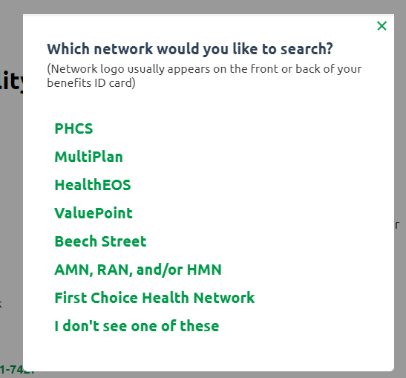
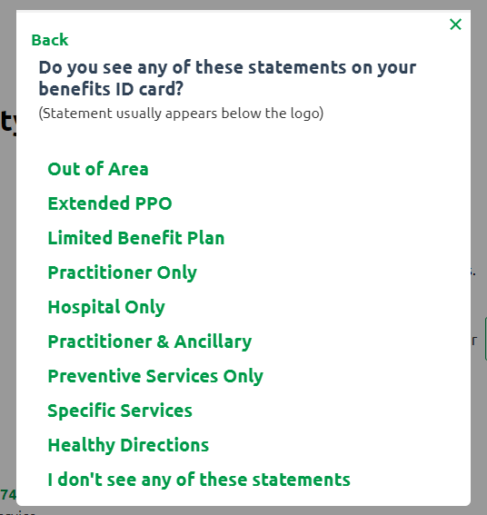
Finding a Doctor
Start by visiting: https://www.multiplan.us/
Click the “Find a Provider” button in the upper right-hand corner
Click “Select Network” to view a list of options
Select the first option, “PHCS”
Next, click on
“Practitioner and Ancillary”
You will now be able to search by name, specialty or facility type near your specified city and state or zip code

Slide 19
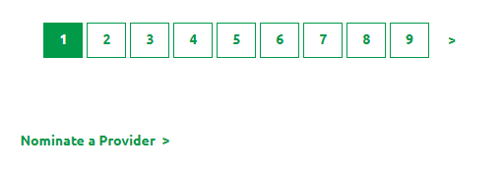
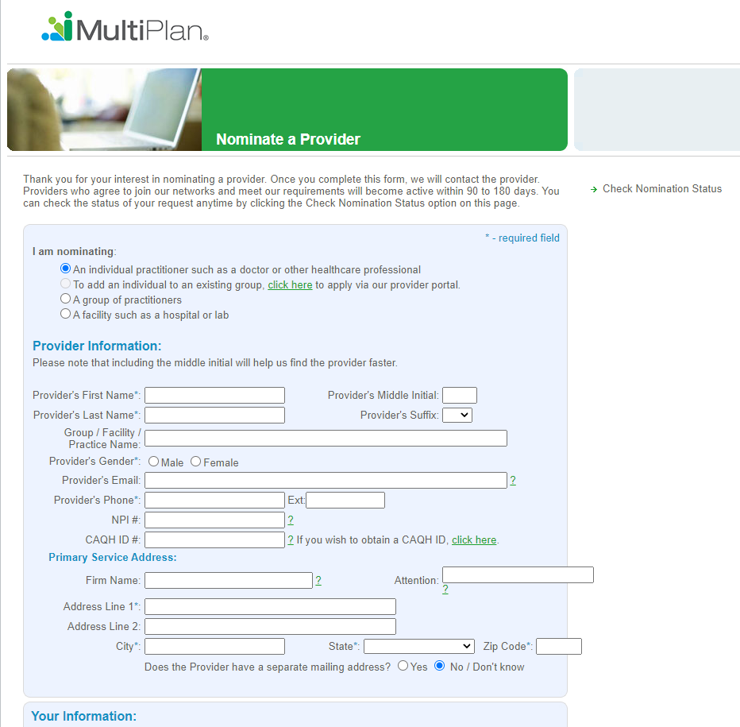
Nominating a Doctor
If you don’t see your doctor you can ask PHCS to contact them for inclusion. At the bottom of the search results click
“Nominate a Provider”
Complete the form and submit

Slide 20
Thank You!
We look forward to discussing next steps.
TO LEARN MORE ABOUT THE IWCA MEDICAL PLAN PLEASE CONTACT
STEVE WILSON
(773) 203 – 6104
STEVE.WILSON@CBIZ.COM
CBIZ Employee Benefits is proud to be your master broker of the 2022 IWCA National Medical Partnership Program

