Slide 2
What is COVID-19?
COVID-19 is the short name for “coronavirus disease 2019.” It is a new virus. Doctors and scientists are still learning about it.
Recently, this virus has made a lot of people sick. Scientists and doctors think that most people will be ok, especially kids and healthy adults, but some people might get pretty sick, elderly or anyone with underlying health issues. Smokers are at an increased risk as well.
Doctors and health experts are working hard to help people stay healthy.

Slide 4
What can I do to stay healthy?
You can practice healthy habits at home, work, school, and play to help protect against the spread of COVID-19:
Cough or sneeze into a tissue or your elbow. If you sneeze or cough into a tissue, throw it in the trash right away.
Keep your hands out of your mouth, nose, and eyes. This will help keep germs out of your body.
Maintain a social distance from others (refrain from hand holding/touching) and limit food sharing
Wash your hands with soap and water for at least 20 seconds. Follow these five steps—wet, lather (make bubbles), scrub (rub together), rinse and dry. You can sing the “Happy Birthday” song twice.
If you don’t have soap and water, use a special hand cleaner/sanitizer.
Keep things clean. At home, work, and school - clean the things we touch the most, like desks, doorknobs, light switches, surfaces we touch, and remote controls.
If you feel sick, stay home. Just like you don’t want to get other people’s germs in your body, other people don’t want to get your germs either.

Slide 5
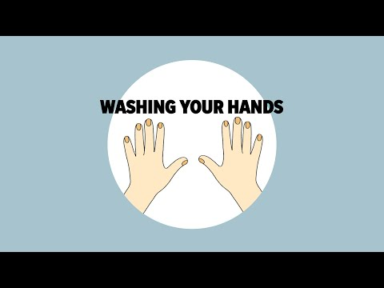
https://youtu.be/d914EnpU4Fo
Notes:
https://youtu.be/d914EnpU4Fo

Slide 6
For more information visit:
CDC Information for COVID19: https://www.cdc.gov/coronavirus/2019-ncov/index.html
Washing Your Hands Video from the CDC: https://youtu.be/d914EnpU4Fo
ISSA Website: https://www.issa.com/
OSHA Guidelines for COVID-19: https://www.osha.gov/Publications/OSHA3990.pdf
EPA Website: https://www.epa.gov/

