Slide 1
Testing for Opioids and Cannabis in the Workplace: What Should Employers Know?
Presented by: Travis W. Vance
(704) 334-4565 tvance@fisherphillips.com

Slide 2
The Opioid Crisis

Slide 3
Why this Topic Matters
As many as 50,000 Americans may have died last year alone of opioid-related overdose.
A recent study showed 2 million Americans had a substance abuse disorder involving prescription pain relievers, while drug overdose is now the leading cause of death of Americans under the age of 50.
- Abuse of the drug has had tragic consequences across the nation, ravaging communities and tearing apart families.
-Sam Quinones, Dreamland

Slide 4
The Future Doesn’t Look Good
There are now nearly 100 deaths a day from opioids, a swath of destruction that runs from New England
to the Appalachian foothills
That toll could spike to 250 deaths a day, if potent synthetic opioids like fentanyl continue to spread rapidly and the waits for treatment continue to stretch weeks in hard-hit states like West Virginia and New Hampshire

Slide 5
Why the Crisis Occurred
- Opioids may be found in any medicine cabinet.
- This group of drugs includes the regularly prescribed painkillers oxycodone, hydrocodone, morphine, and fentanyl.
- These drugs interact with opioid reactors on nerve centers in the brain to create a pleasurable experience and relieve pain.
- Due to the relief they experience, consumers of these drugs often become dependent upon them.
- Once addicted, individuals may turn to heroin, which, although illegal, is often a cheaper and more accessible opioid. In fact, approximately four in five heroin addicts developed their addiction after taking prescription painkillers.

Slide 6
Why Employers Play an Important Role in this Crisis
Employees may be prescribed opioids to relieve pain following a workplace injury, which could begin a path to dependency.
Opioid dependency often leads to drowsiness, shifting moods, anxiety, and depression.
An employee with an opioid addiction may struggle to maintain regular attendance, achieve quality goals, or pose a safety hazard to him or herself and coworkers.
Addiction to these drugs usually also causes financial issues because the addict is in constant search for a fix. This could lead to cases of workplace theft or embezzlement.

Slide 7
Why Employers Play an Important Role in this Crisis
Interact with employees every day and every week
Employers know if there are issues with employee’s life (e.g., change in behavior, missing work, etc.)
The employee’s addiction may have begun at work (e.g., taking pain medication for the first time after an injury/workers’ compensation claim)
Unfortunately, workplaces are often a marketplace for prescription opioids (originally obtained with a prescription).

Slide 8
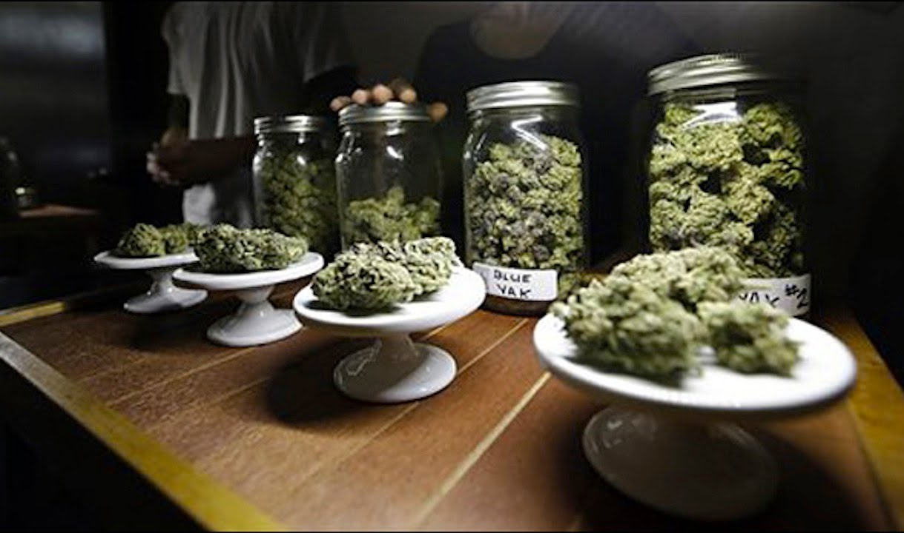
RECREATIONAL & MEDICAL MARIJUANA

Slide 9
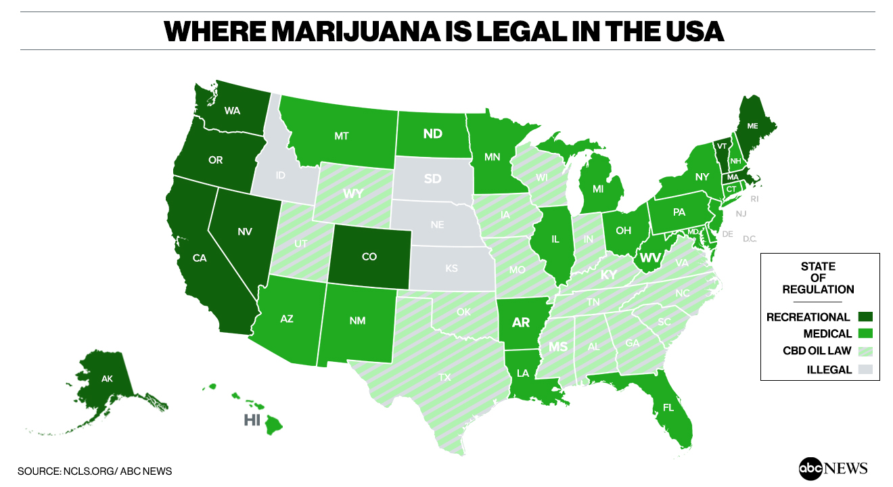
Each state law varies regarding employer obligations and worker rights

Slide 10
Marijuana In The Workplace
Employers do not need to allow use or possession at work
But what about offsite use and positive drug tests?
Employers won decisions in California (2008), Oregon (2010), Washington (2011), Montana (2012), Colorado (2015), and New Mexico (2016) –do not have to accommodate medical marijuana use
Barbuto v. Advantage Sales & Marketing
(Massachusetts July 27, 2017)
Employees might be entitled to accommodations
Employers must engage in interactive process

Slide 11
Recreational Marijuana
10 states and D.C. now permit recreational marijuana (Alaska, California, Colorado, Maine, Massachusetts, Michigan, Nevada, Oregon, Vermont, and Washington)
Zero-tolerance policies and practices may still be permitted
How to handle inquiries from employees?
What if you want to have a more relaxed standard?
Consider safety-sensitive positions and federal obligations before acting

Slide 12
“Good people don’t smoke marijuana…” 4/5/16
“It remains a violation of federal law to distribute marijuana throughout any place in the US, whether a state legalizes it or not” 2/27/17
Sessions
Memo
1/4/18

Slide 13
Drug Testing: A Case Study
On March 29, 2018, you learn that an accident involving a
forklift occurred at 2:00 p.m. the day before, March 28.
The employee driving the forklift suffered an injury,
drove himself to the hospital and was admitted overnight.
Neither the injured employee nor the two employee
witnesses informed management of the accident.

Slide 14
Case Study (Cont’d)
1. Can you drug test the employee?
A. Yes B. No
2. Can you discipline the employees for not notifying management of the accident/injury?
A. Yes B. No
3. Do you have a safety bonus program? Does this accident impact it?
A. Yes B. No

Slide 15
OSHA’s New-ish Drug Testing Rule (December 1, 2016)
OSHA has stated that a blanket post-accident drug testing policy may be improper.
Drug testing can be conducted post-accident if:
the employer has a reasonable basis for concluding that drug or alcohol use could have contributed to the injury or illness;
the test will determine if the impairment existed at the time of the accident/injury (if available); or
State law allows such testing.

Slide 16
Other Factors Considered
Whether the employer had a reasonable basis for concluding that drug use could have contributed to the injury or illness (and therefore the result of the drug test could provide insight into why the injury or illness occurred);
Whether other employees involved in the incident that caused the injury or illness were also tested or whether the employer only tested the employee who reported the injury or illness (e.g., the injured employee); and
Whether the employer has a heightened interest in determining if drug use could have contributed to the injury or illness due the hazardousness of the work being performed when the injury or illness occurred

Slide 17
Common Questions - What if my workers compensation carrier requires drug testing after every accident? - What if I get a discount from my workers’ compensation insurer if I drug test after every accident?

Slide 18
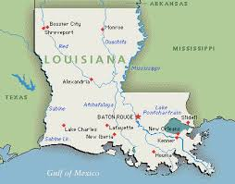
Exceptions
If your state workers’ compensation insurance program allows or mandates post-accident drug testing:
The Louisiana Rule: “For purposes of this Section, the employer has the right to administer drug and alcohol testing or demand that the employee submit himself to drug and alcohol testing immediately after the alleged job accident.” La. Stat. Ann. § 23:1081(7)(a).

Slide 19
Exceptions
2) Your state workers’ compensation insurance plan gives you a discount on your insurance premiums if you have a drug free workplace policy in place, and your insurer’s program complies with the state requirements:
The Virginia Rule: “Every insurer providing coverage pursuant to this title shall provide a premium discount of up to five percent to every employer instituting and maintaining a drug-free workplace program satisfying such criteria as each insurer may establish.” Va. Code Ann. § 65.2-813.2.

Slide 20
Drug Testing – Enforcing Rule?
In October 2018, OSHA issued guidance that appears to roll back its December 2016 drug testing rule. Now, the following types of drug-testing should be permissible:
Random drug testing.
Drug testing unrelated to the reporting of a work-related injury or illness.
Drug testing under a state workers’ compensation law.
Drug testing under other federal law, such as a U.S. Department of Transportation rule.
Drug testing to evaluate the root cause of a workplace incident that harmed or could have harmed employees. If the employer chooses to use drug testing to investigate the incident, the employer should test all employees whose conduct could have contributed to the incident, not just employees who reported injuries.

Slide 21
What about a policy relating to property damage?
The Company will drug test if there is
$250 in property damage
The Company will drug test if there is
$1,000 in property damage
The Company will drug test if there is
substantial property damage

Slide 22
Best Practices

Slide 23
Elements of an Effective Drug Testing Policy
At a minimum, a good drug and alcohol policy should contain the following provisions:
The policy should inform employees about why and when testing may occur, and what may happen if the test is failed.
The policy should clearly define what substances are prohibited. The definition of prohibited substances should include illegal drugs and legal drugs that are abused or used without a prescription. Working while under the influence of drugs or alcohol should be prohibited.
The policy should prohibit possession, manufacture, distribution, dispensation, transfer, and sale of prohibited substances while on company premises, on company time, or while in company vehicles.
The policy should address the failure to cooperate in company investigations of substance abuse.
The policy should advise the employees that the employer reserves the right to search lockers, desks, and other company property, and any personal property or personal vehicles on company premises. An employer may want to reserve the right to conduct personal searches, but these searches entail legal risks and should be conducted with caution.

Slide 24
Create an Environment Where Employees are More Likely to Disclose Opioid-Related Issues
Consider encouraging employees to tell you when they have a problem or suspect that another employee may have an issue with prescription painkillers.
This starts by creating a workplace environment conducive to the free exchange of information.
This is an evolving area of human resources and business management; you must balance the concern of being viewed as an employer who attempts to invade employees’ private home life versus later dealing with an employee who quits, overdoses, or creates a safety concern due to an addiction you may have ignored.
Also helps with workplace violence issues (e.g., restraining order)

Slide 25
Create an Environment Where Employees are More Likely to Disclose Opioid-Related Issues
The key to preventing opioid addiction is educating employees on the potential harmful impacts of abusing painkillers.
If you become aware of an employee’s potential abuse of opioids, attempt to approach the employee in a cordial, non-confrontational manner to offer assistance with this condition.
Pay special attention to employees returning to work after an injury.
Consult your counsel on navigating any potential ADA or HIPAA issues. Addressing these issues early may help prevent a larger issue later.

Slide 26
Reconsider Zero Tolerance Drug Testing Failure Policies
An employee who loses his or her job because they fail a drug test may fall further into the depression often caused by opioid use.
Unemployment may lead to more drastic outcomes for the employee, including intentional or accidental overdose.
In order to avoid such a tragedy, employers should revisit their zero tolerance drug testing policy.

Slide 27
Reconsider Zero Tolerance Drug Testing Failure Policies
Many employers are modifying their drug testing policy due to OSHA’s recent new rule.
Effective December 1, 2016, OSHA’s new rule requires employers to drug test after a workplace accident only when you have a reasonable basis to believe that the incident or injury was likely to have been caused by the employee’s impairment, and that the drug test will determine whether the employee was impaired at the time of the incident or injury (versus a test that shows mere historical drug use).
When modifying their drug testing policy, and in light of the opioid epidemic, employers should think seriously about removing any provision requiring the automatic termination of the employee after the first positive drug test.
Instead, employers can amend the policy to include required counseling for employees who fail drug tests. This not only gives the employee a second chance to become “clean” and attempt to end their dependency, it also provides the employee with an opportunity to obtain much needed education and counseling on their condition. The permitted use of prescription drug use while working at the worksite must also be clearly explained in the policy.

Slide 28
Consider Enhanced Monitoring of Workers’ Compensation Claims
Many workers’ compensation carriers (and even employers) often seek to minimize the potential impact of workers’ compensation claims by finding the most inexpensive treatment option possible.
Carriers may be more inclined to pay for opioid prescriptions to “treat” an on-the-job injury versus considering more aggressive treatment options (i.e., steroid injections, surgical intervention, etc.) in the first instance (even when medical providers recommend more aggressive treatment).
As such, there can be a higher incident of dependency – and increased tolerance levels in the event of a future surgery – simply in the name of reducing the financial impact of a workers’ compensation claim. Employers should monitor these trends, and even their medical providers, and evaluate the care provided to injured workers.

Slide 29
Revisit and Enhance Drug Counseling Programs
Now is the time for employers to evaluate and enhance their drug counselling programs.
Does your insurance provider offer drug counseling to employees? Is there an extra cost for this service? Are employees aware of this amenity?
Providing employees robust counseling on opioid use and addiction may prevent further use from occurring.

Slide 30
Final Questions?
Presented by: Travis W. Vance (704) 334-4565 tvance@fisherphillips.com

Slide 31
Thank You
Presented by: Travis W. Vance (704) 334-4565 tvance@fisherphillips.com

